Slide 1
Kaggle Competition: Predicting Housing Sales Price
May 2023
GitHub Account=@Ankit-ai-lab!

Slide 2
Data Exploration
The Purpose is to Predict Housing Price with Least Error (RMSE) trained 5 models, which are proven to be effective, to predict prices based on houses information

Slide 3


The Purpose is to Predict Housing Price with Least Error (RMSE)
We trained 5 models, which are proven to be effective, to predict prices based on houses information
Over 80 Input Variables: Information about houses
Output Variable: Housing Sales Price
Lasso Regression Ridge Regression
Overall Quality
Above-Grade Living Area
Size of garage in square feet
.
.
.
Original construction date
Decision Tree Regressor
Neighborhood
Lot size in square feet
RMSE: Root Mean Squared Error

Slide 4


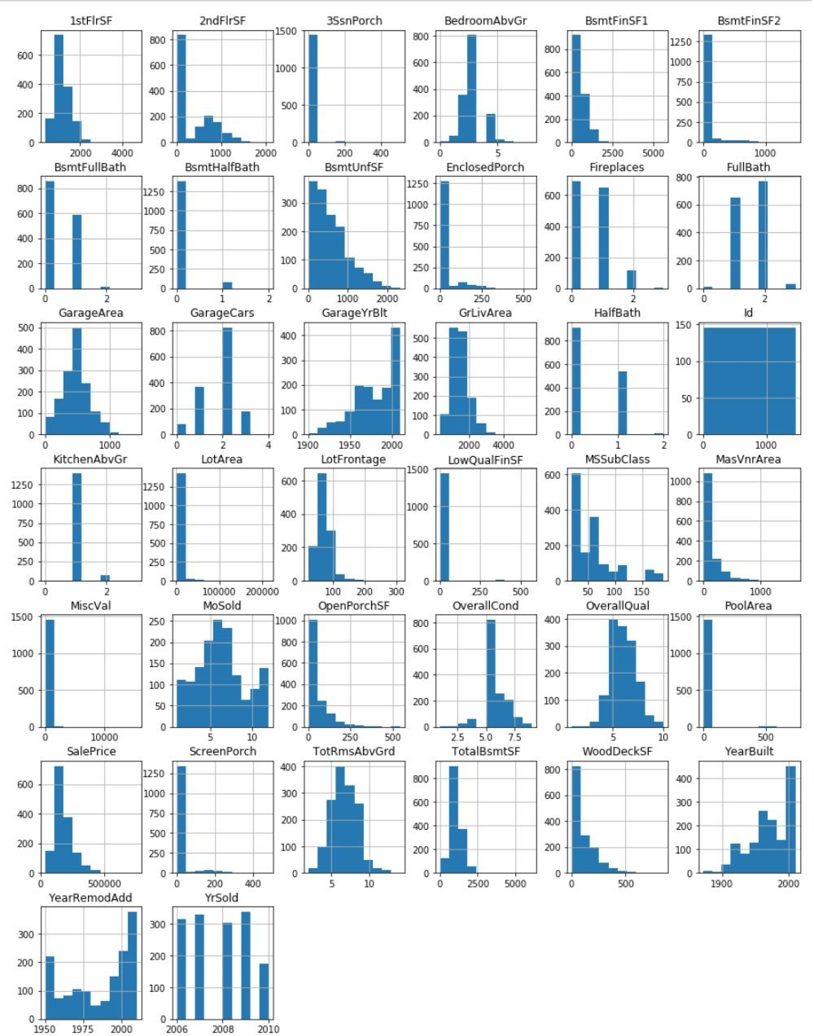
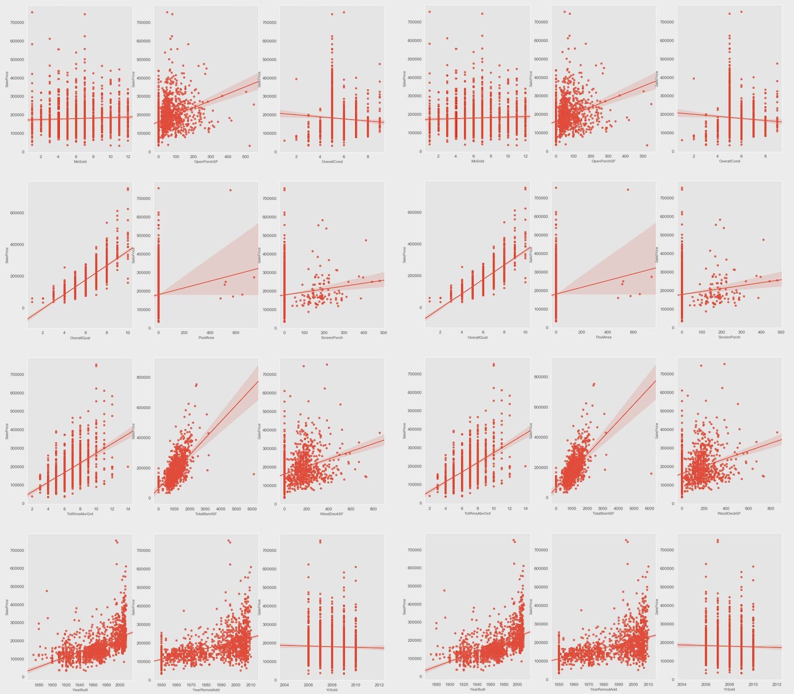
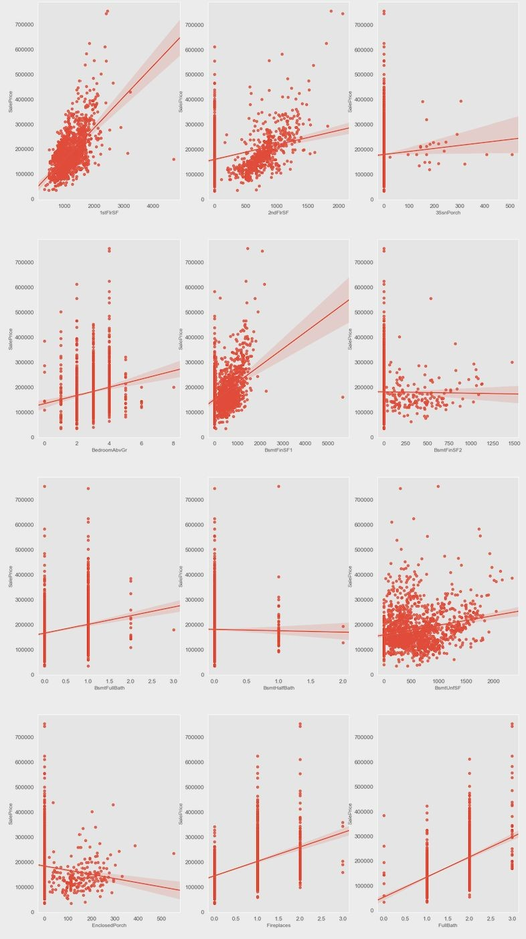
A glance of dataset
Explorating dataset is the foundation of the following pre-processing and modeling
Distributions of variables
Relationship between input and output variables
Some variables are significantly skewed that might need to be standardized
Outliers exist and some variables have strong linear relationship with price

Slide 5
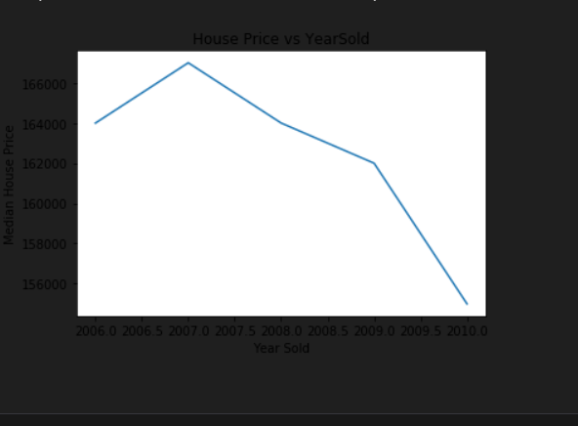
EDA
insight year sold year wise down

Slide 6

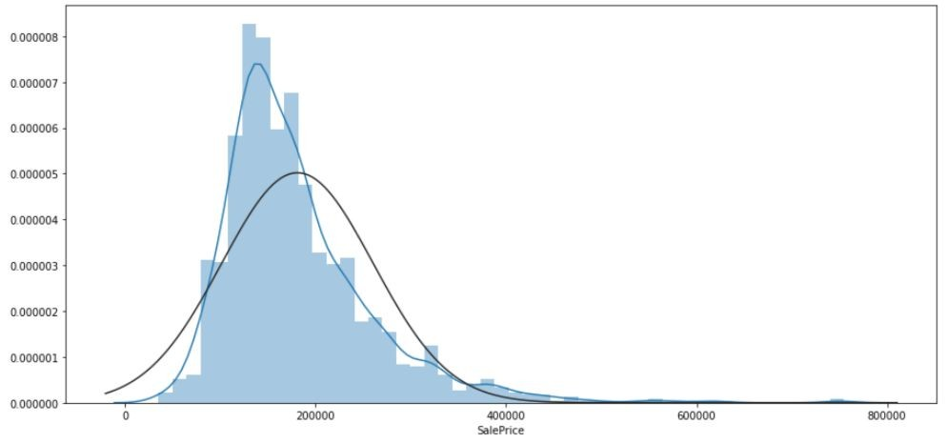
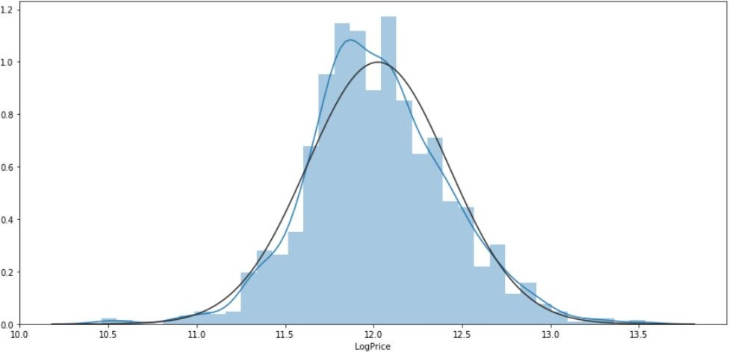
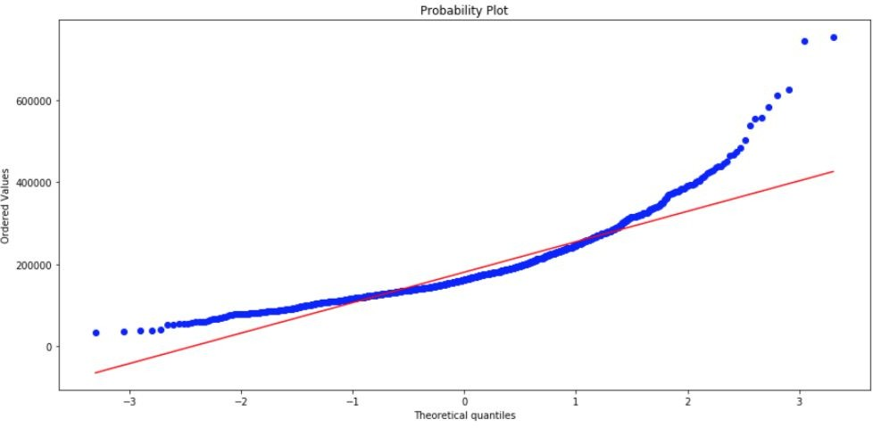
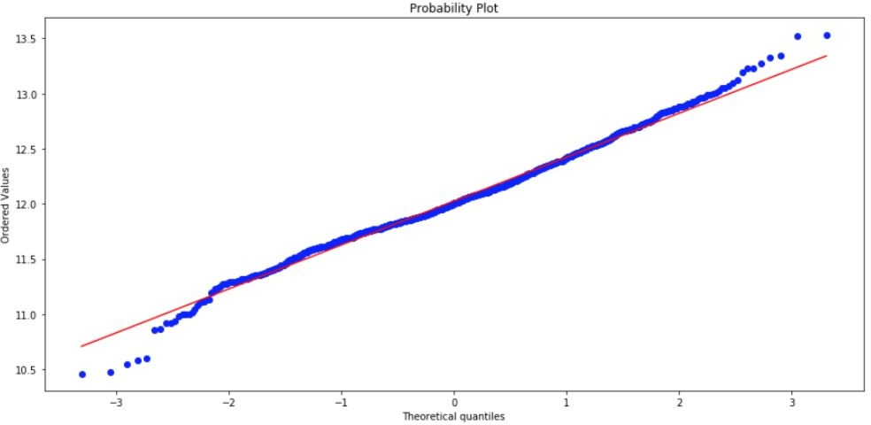
Transform the Target Feature by Taking the Log for Normalization
A violation of normality assumption of linear regression manifests in the target feature that it’s notable right skew.
Before Transformation
After Transformation
Distribution of y
Distribution of y
Normal distribution Normal distribution
It would be advantages to work with the normally distributed output variable (Sales Price)

Slide 7



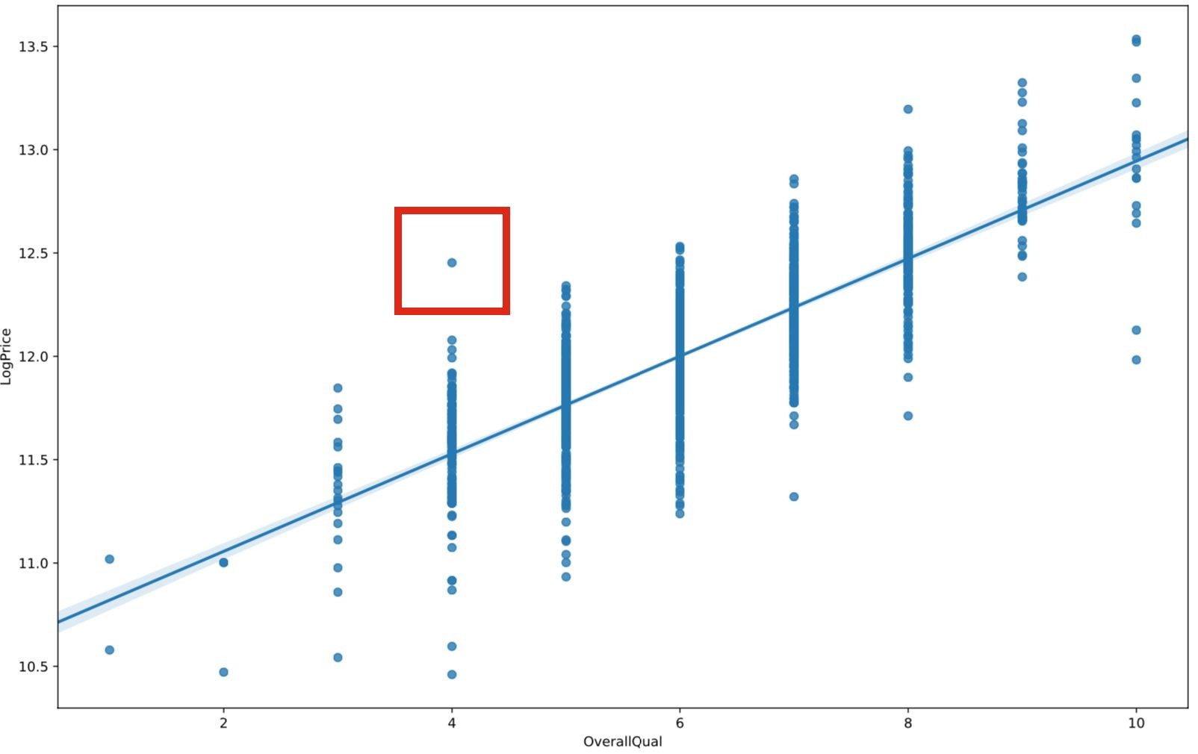
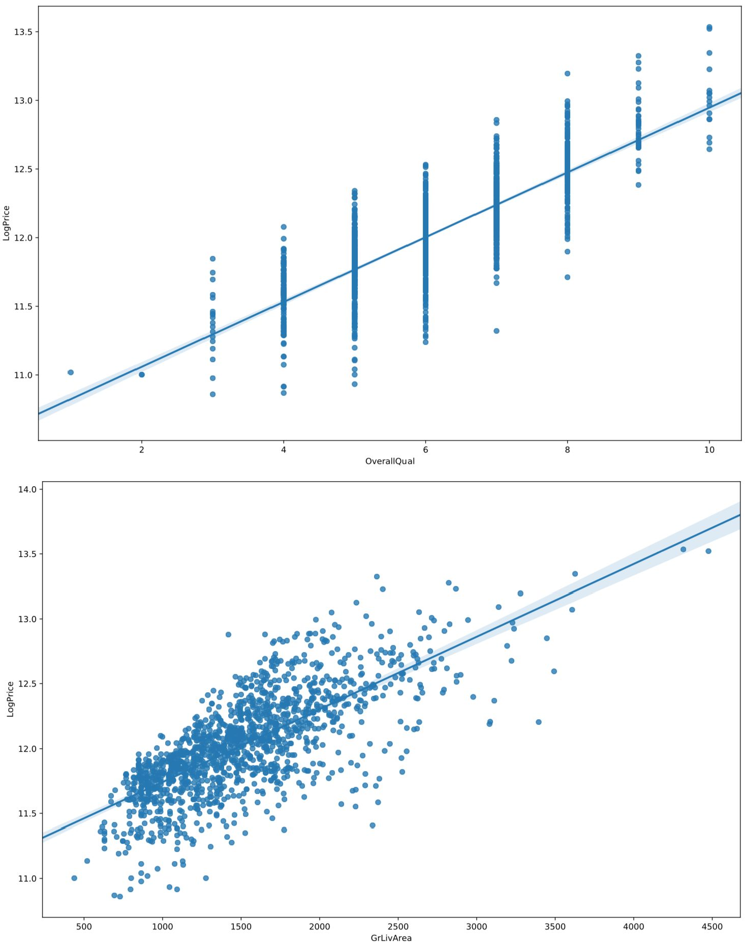
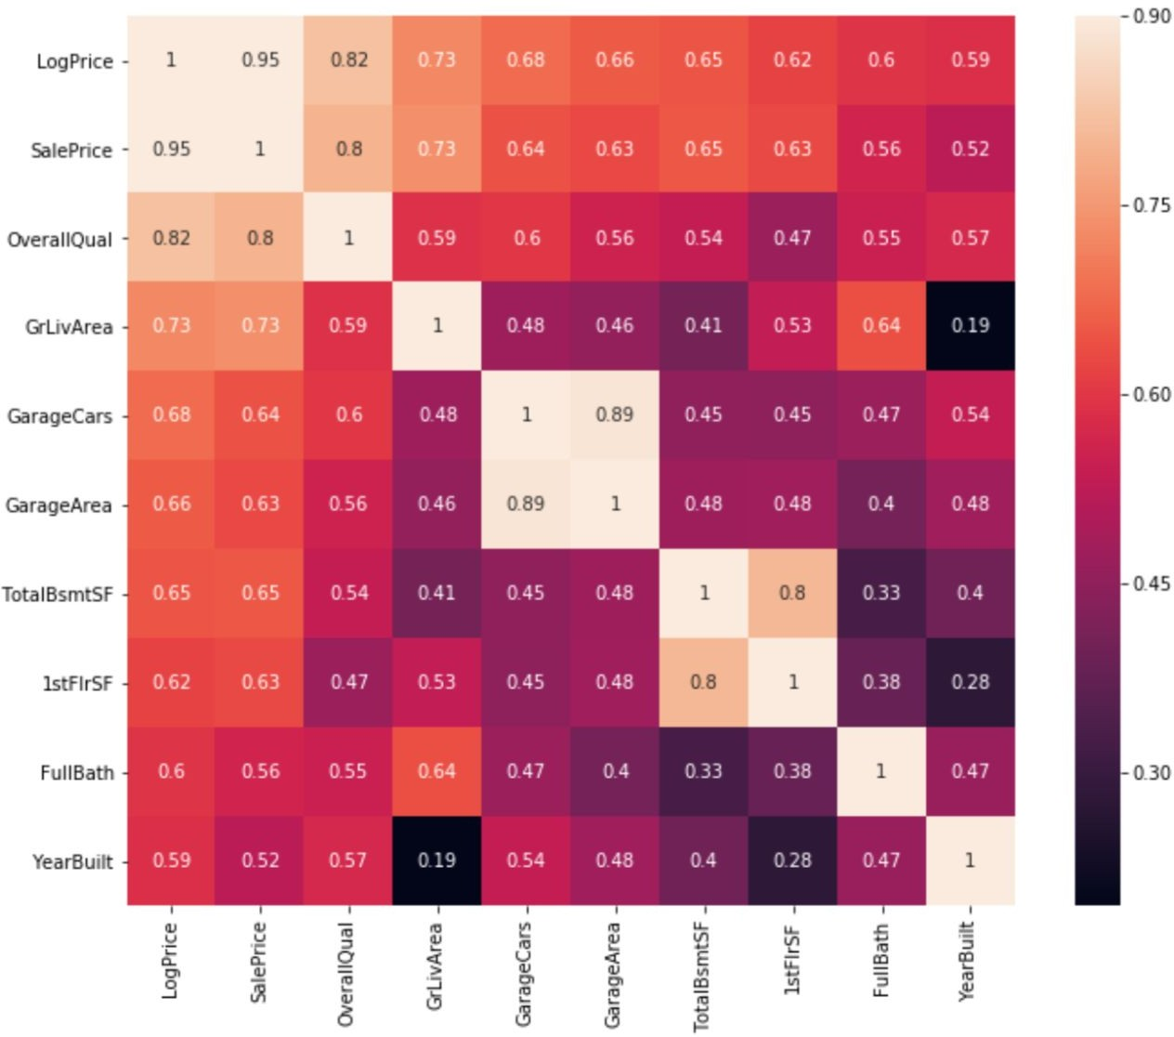
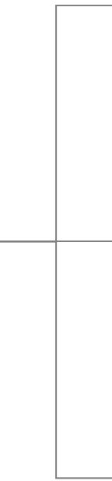

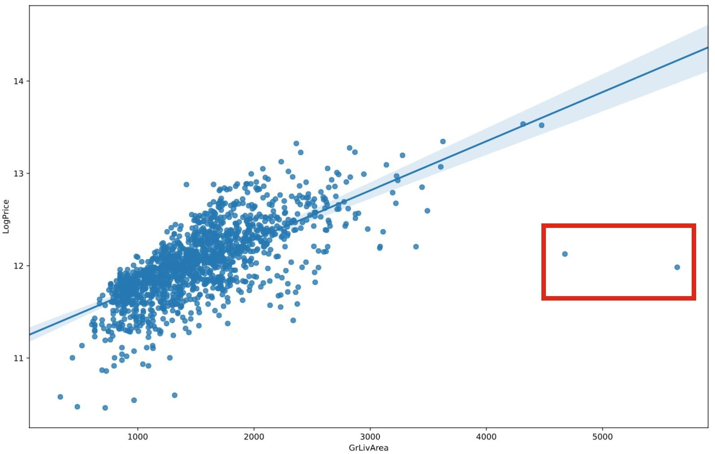

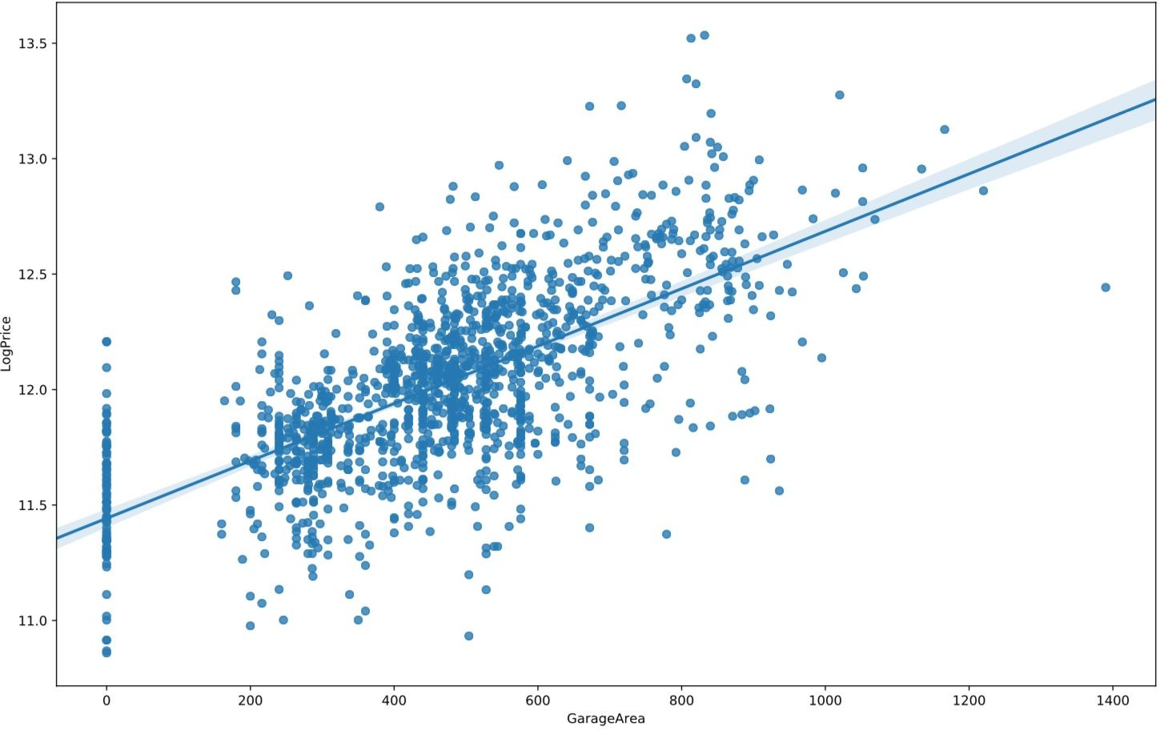
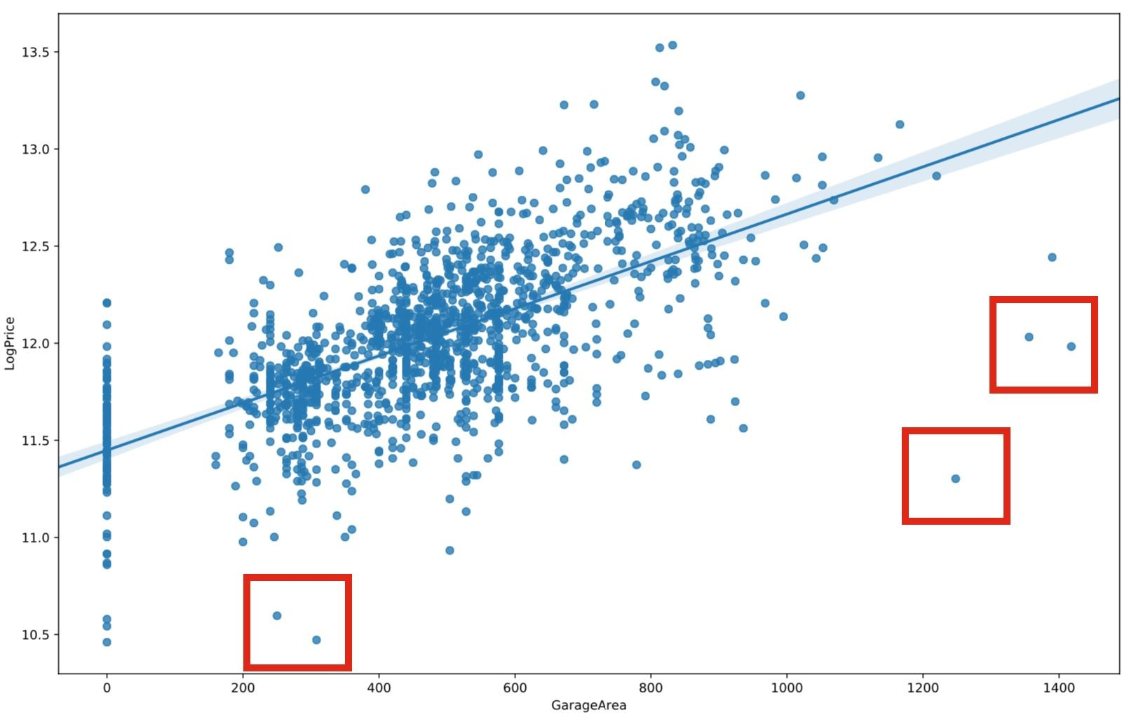
Removing Outliers of Important - Highly Correlated - Features
Filter out outliers in important features that have high correlation with Sales Price and remove them.
Overall Quality
After Removing Outliers
Before Removing Outliers
Above-Grade
Living Area
Size of garage in
square feet
Select important features with high correlation with price

Slide 8
Missing Values

Slide 9

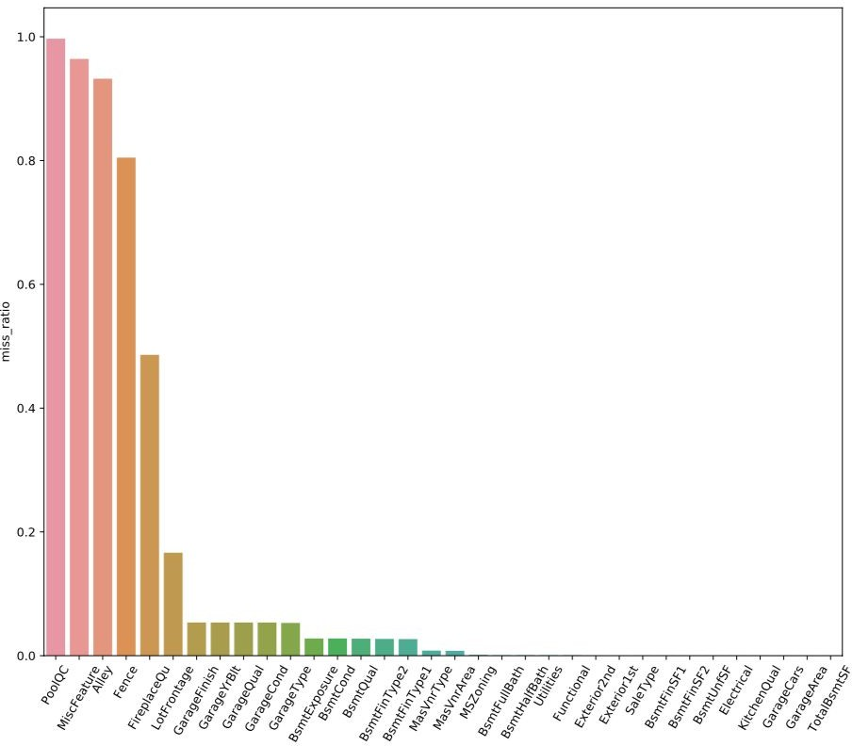
General view of missing values
Ratio of missing values of each feature
Number of Missing values
13965
Train Dataset
Test Dataset
6965
7000
Number of Features with missing values
34
Train Dataset
Test Dataset
19
33

Slide 10
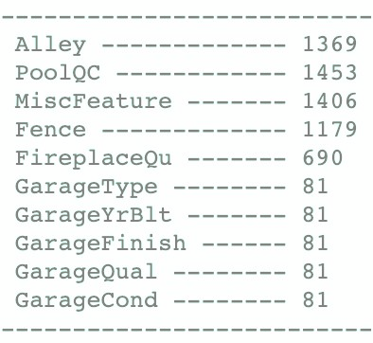

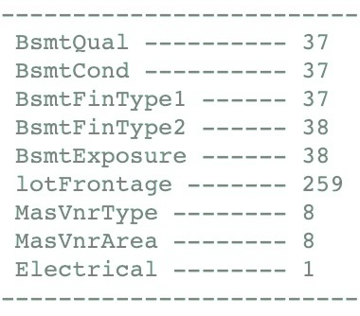

Missing value imputation of train dataset
Pseudo Missing Values
No Alley Access No Pool
All Covered No Fence No Fireplace No Garage
Impute with ‘No ***’
Features
Group
Imputation
Real Missing Values
37 No Basement
Id 949 misses Exposure Id 333 misses FinType2 259 miss lot Frontage
8 miss MasVnrType
8 miss MaxVnrArea
1 Electrical
BsmtExposure BsmtFinType2
Neighborhood YearBuilt
Mode
LotFrontage
Neighborhood
Median
MasVnrType MasVnrArea
Neighborhood YearBuilt
Mode
Electrical
YearBuilt
SBrkr

Slide 11



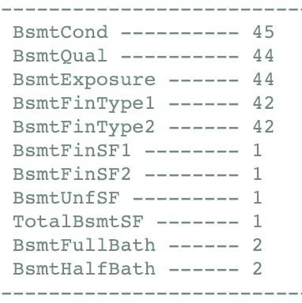
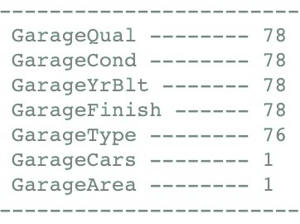
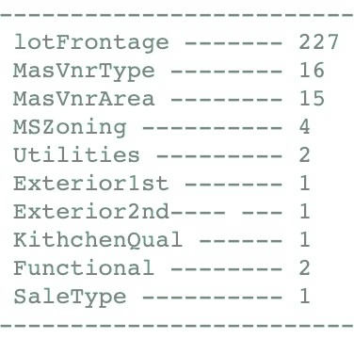




Missing value imputation of test dataset
Id 2218
Id 2219
Id 2349
Wrong inputs
No Basement
Id 2127
Id 2577
Wrong inputs
No Garage
LotFrontage MasVnrType MasVnrArea MSZoning Utilities Exterior KitchenQual Functional SaleType
Median None+BrkFace 0
RM+RL
AllPub VinylSd TA
Mod WD

Slide 12
Feature Engineering

Slide 13





Dealing with different types of data
Grouping data into different categories can help to sort through it and organize it effectively
Type of variable Transformation Examples
Continuous
Just ensure that the variable is numeric:
LotFrontage, LotArea, MassVnrArea, BsmtFinSF1
column.astype('float64')
Simply esure that the data
Ordinal Categorical
Manually encode the variables:
OverallQual, OverallCond, ExterQual, BsmtCond
[‘Po’, ‘Fa’, ‘Av’, ‘Gd’, ’Ex’]
[2, 4, 6, 8, 10]
Nominal Categorical
Dummify the variables:
MSSubClass, MSZoning, LotConfig
pd.get_dummies(column)

Slide 14
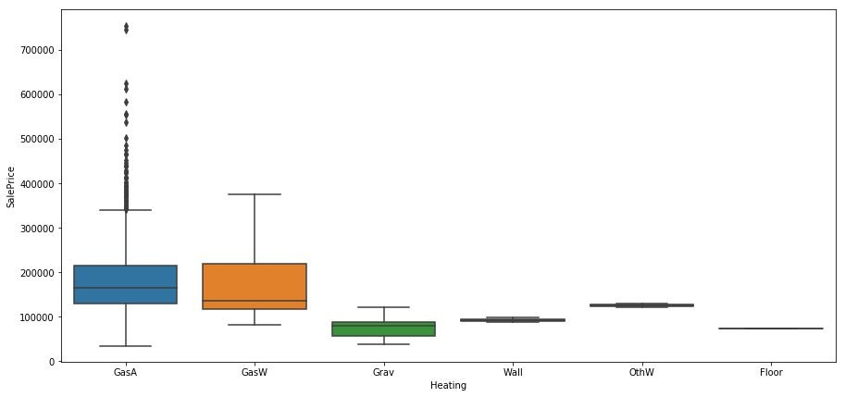


Dummifying Data
When dummifying, every category will form its own column. Many will not be numerous enough or different enough to form meaningful variables, so we group them:

Slide 15


Dummifying Data
RoofMat1
[‘Membran', 'ClyTile', 'Metal', 'Roll', 'WdShngl', 'WdShake']
‘Others’
PoolQC
['Ex', 'Gd', 'Fa' ‘Have_Pool’]
‘Have_Pool’
Condition2
['RRAn', 'RRAe' ]
[RRNn', 'Artery', and 'Feedr']
‘Norm’ ‘Other’
['PosA', 'PosN']
‘Pos’
Heating
['Wall', 'OthW', 'Floor']
‘Other’
MiscFeatures
['TenC', 'Othr']
‘Other’

Slide 16


Dealing with Skewness
Reducing the skew in our continuous or ordered features will help our modeling. We applied the box-cox transformation to particularly skewed data.
If skew > threshold
Calculate skewness after log transform
If log transform reduces skew
Apply log transform, repeat.
For some variables, we found it was better to manually apply power transformations to reduce extreme skew. This was done for BsmtCond, BsmtQual, GarageCond, and GarageQual.

Slide 17



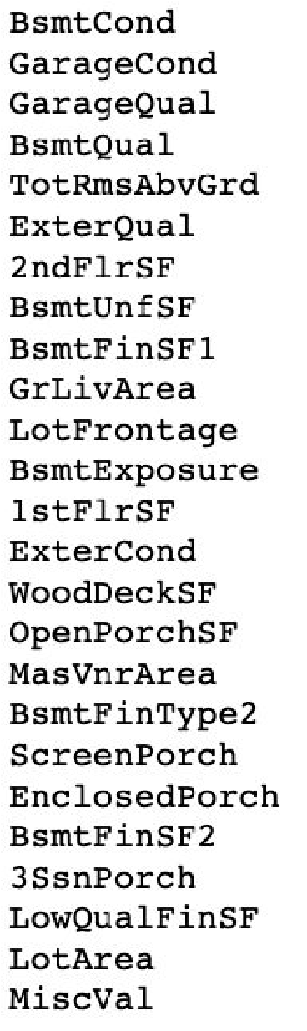
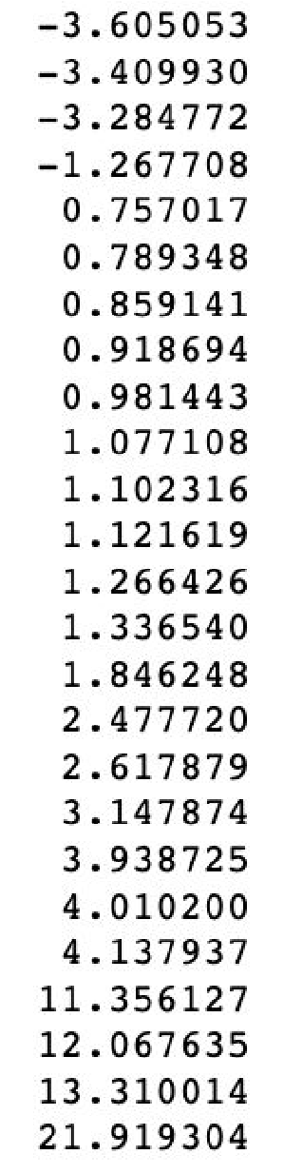
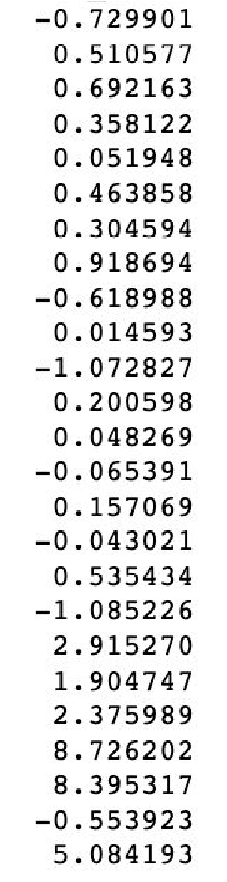
Dealing with Skewness
Skewed Data
Before Transformation
After Transformation
Skewed Data

Slide 18
Model Fitting

Slide 19

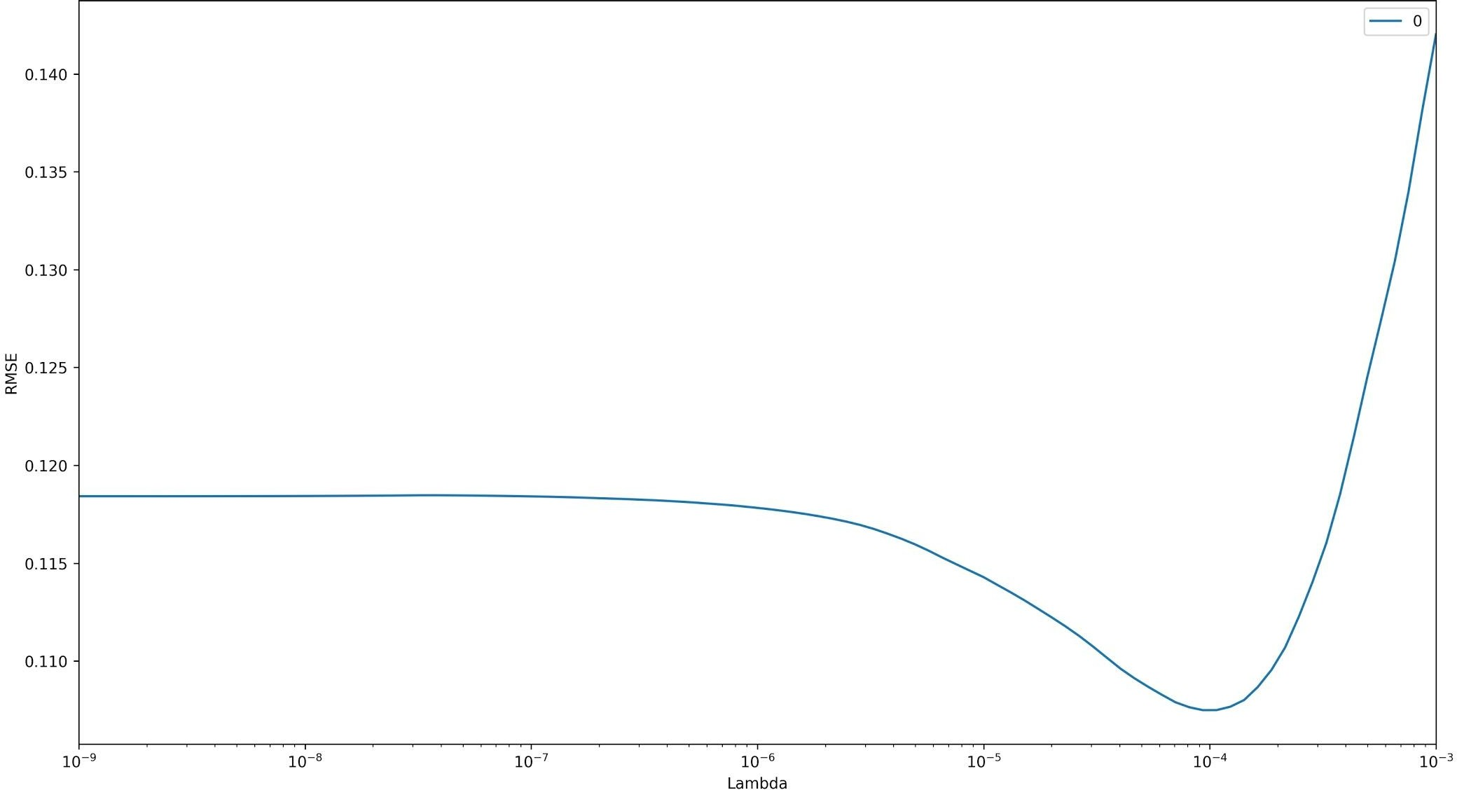
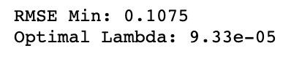
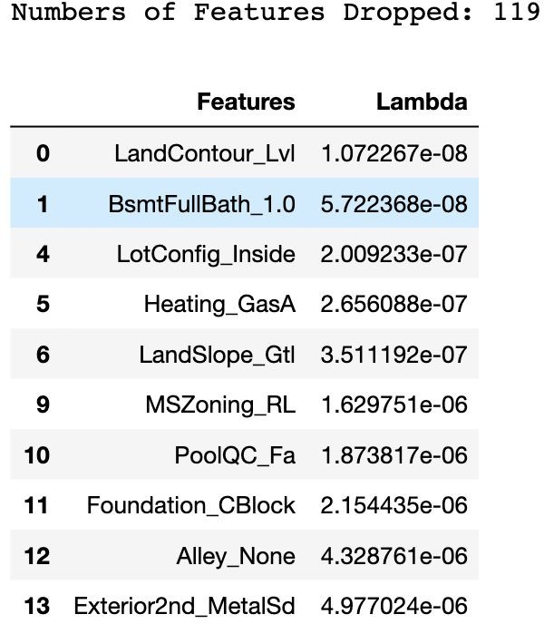
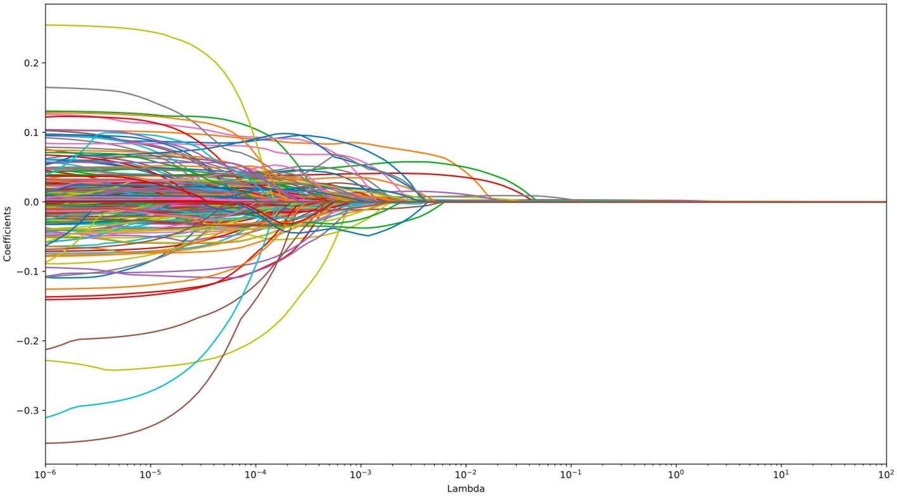
Feature Selection via Lasso Regression
Analyze the lasso regression plot to decide which features need to be dropped
rMSE ~ λ | coeff ~ λ
Feature Dropped

Slide 20

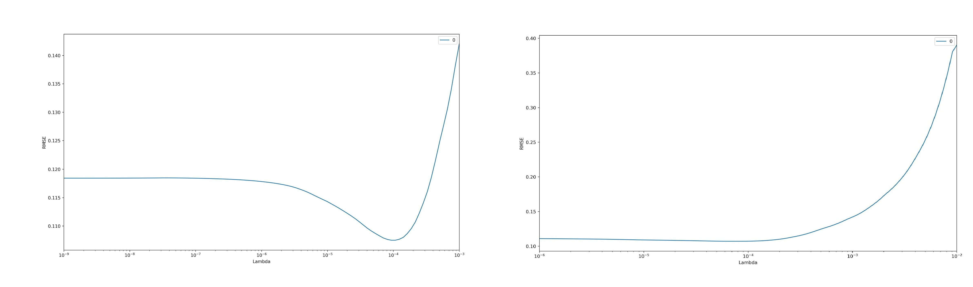
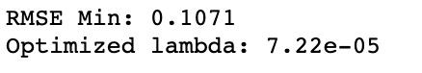
Parameter Optimization of Lasso Regression
Comparison of feature selection
Before Feature Selection
After Feature Selection

Slide 21
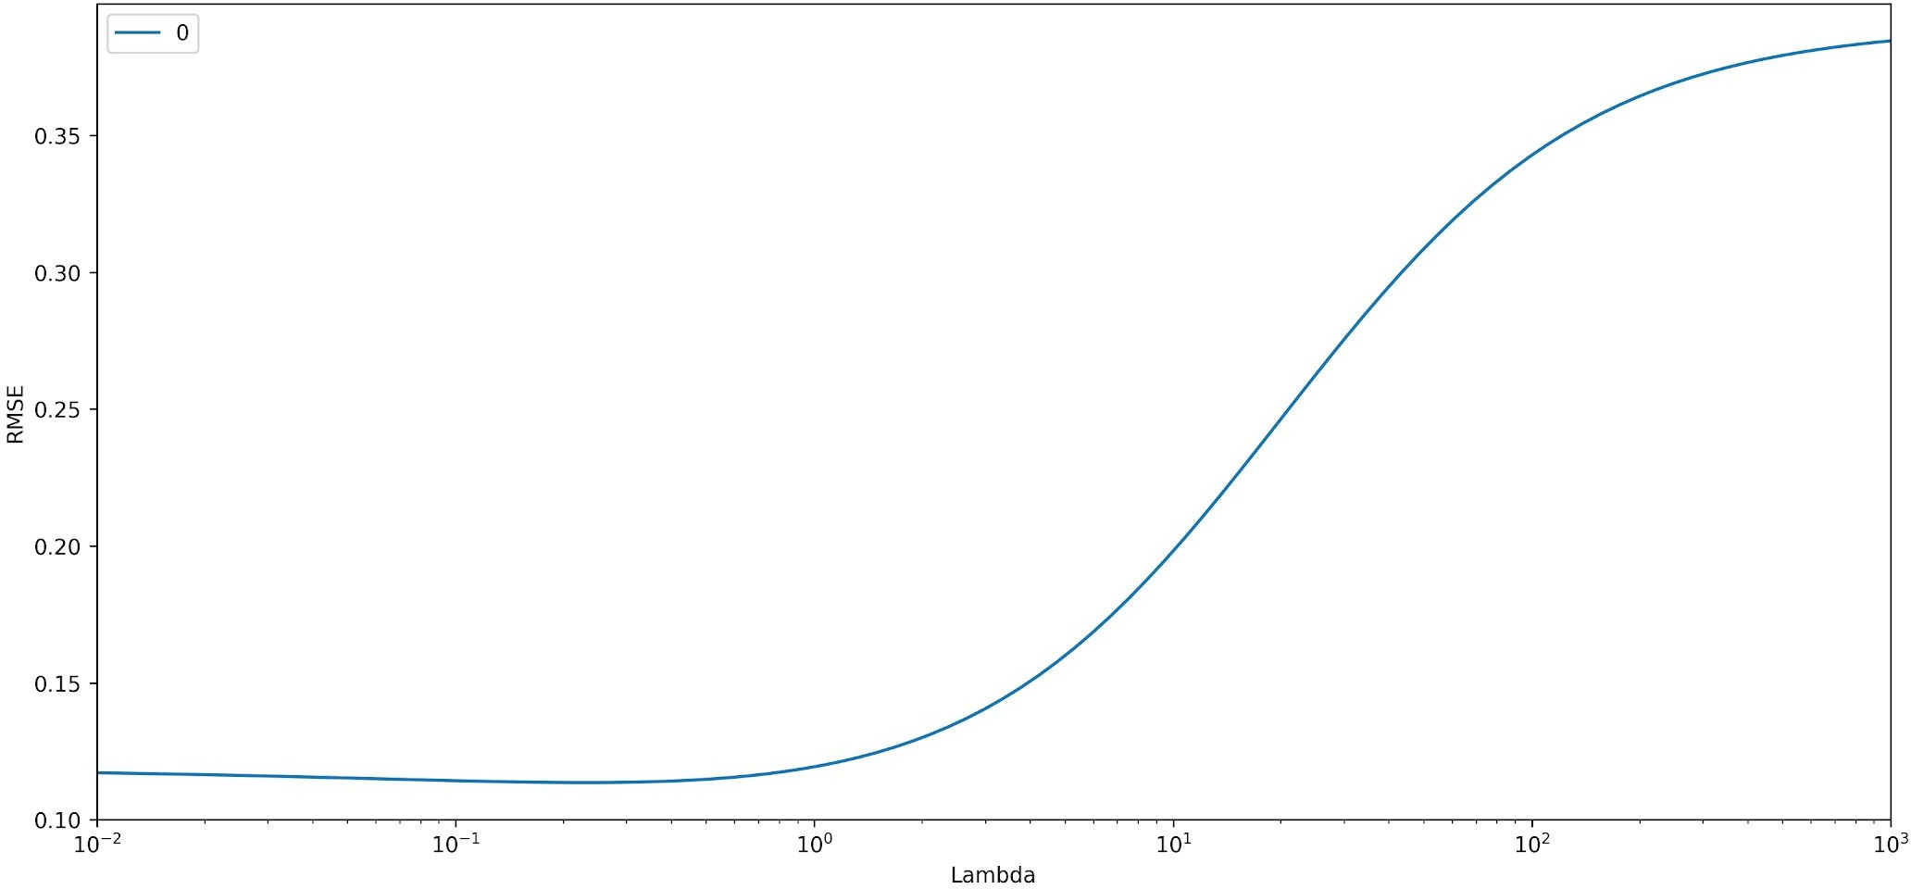
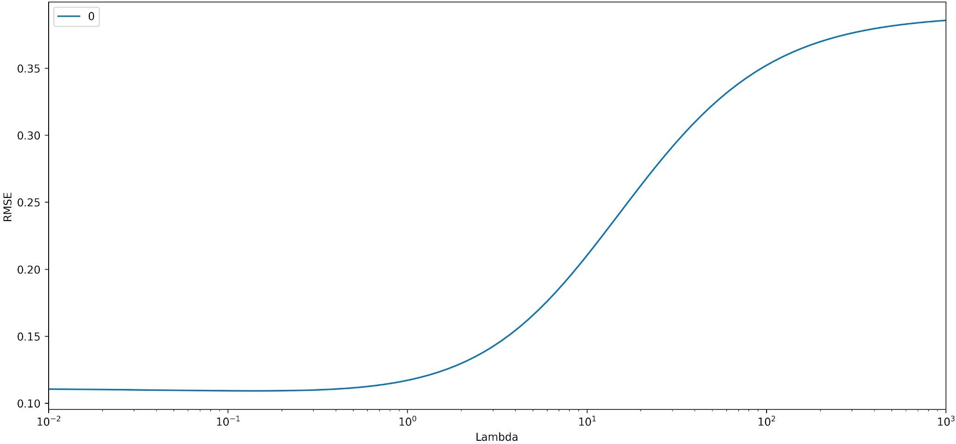
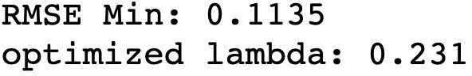
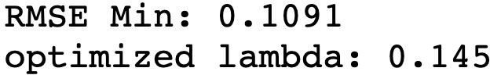
Parameter Optimization of Ridge Regression
Comparison after feature selection
Before Feature Selection
After Feature Selection

Slide 22
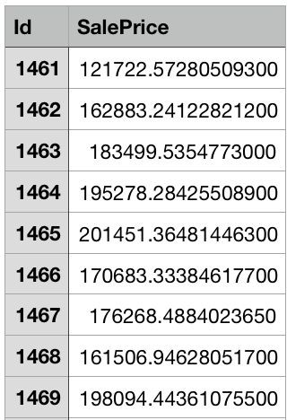

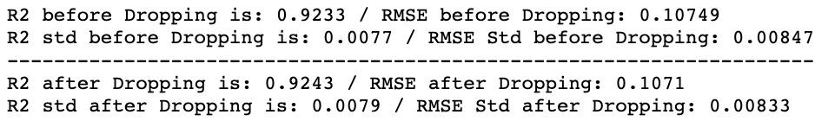
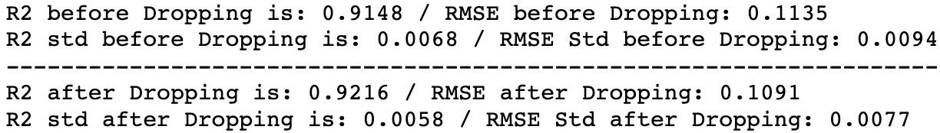
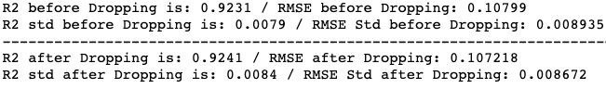

Price Prediction by Elastic Net Regression
Model comparison and price prediction
Lasso Regression
Ridge Regression
Lasso
Elastic Net Regression

Slide 23

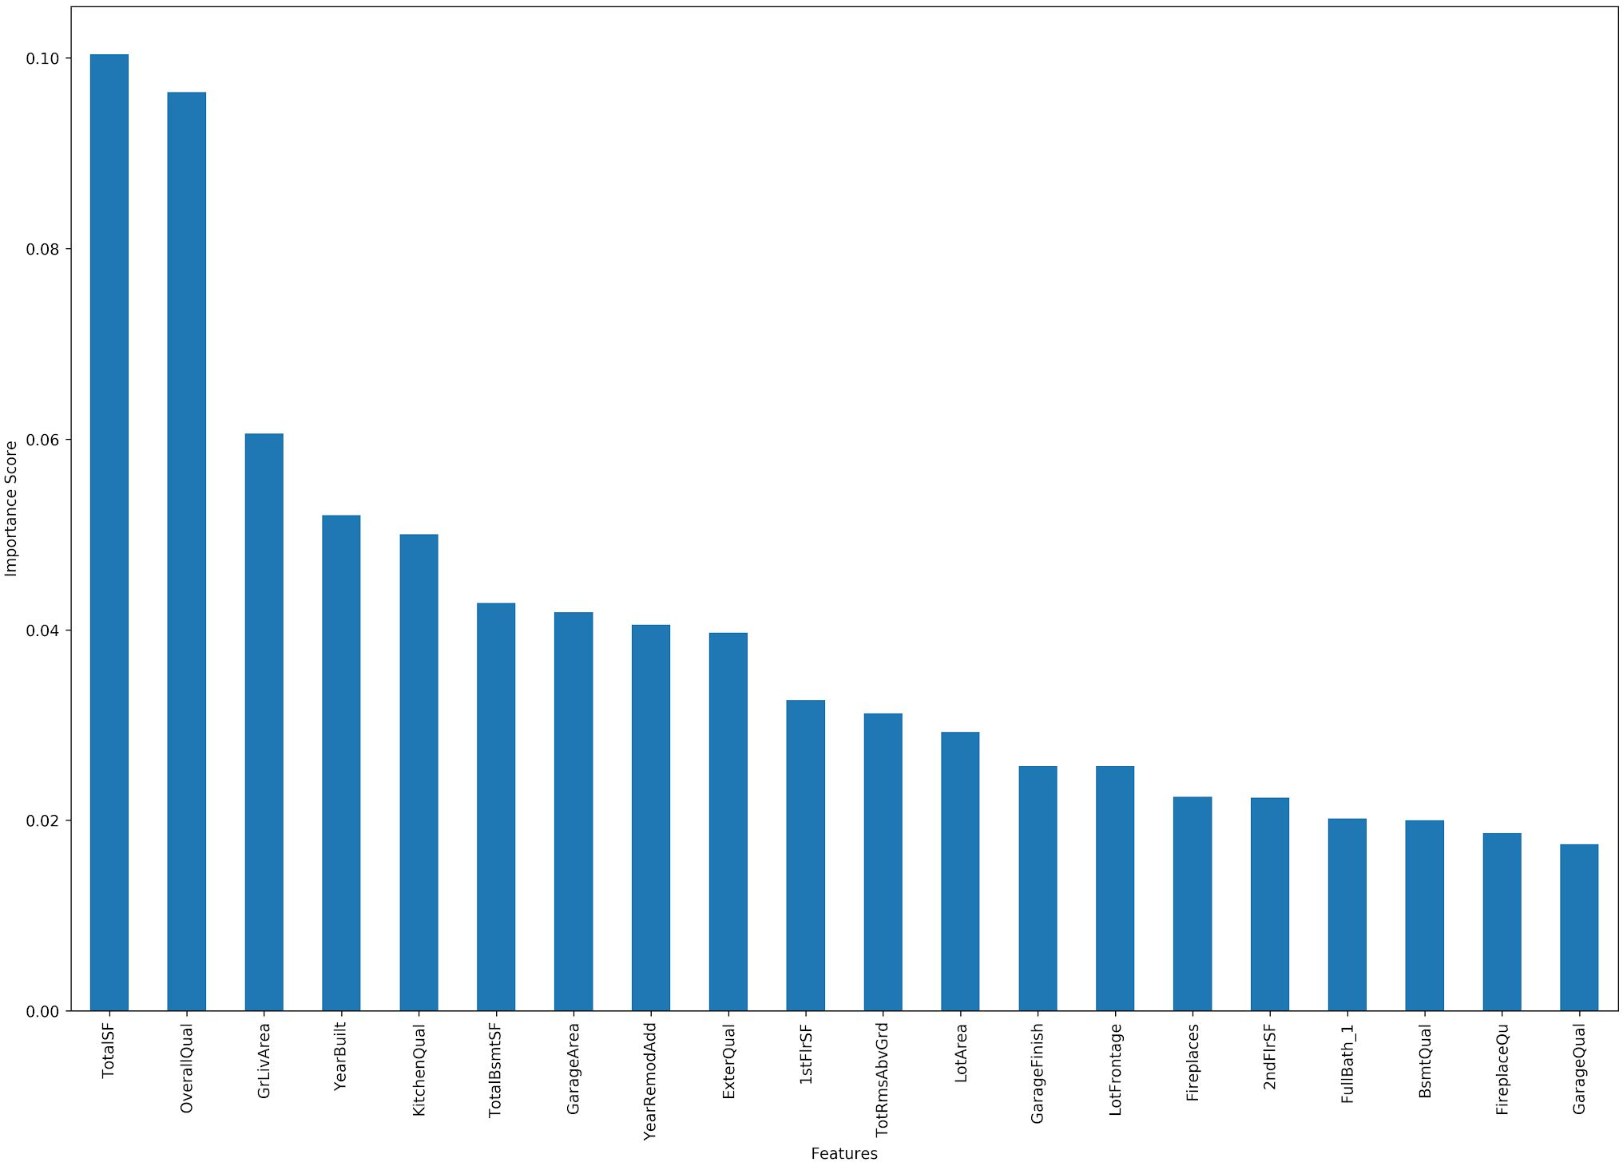
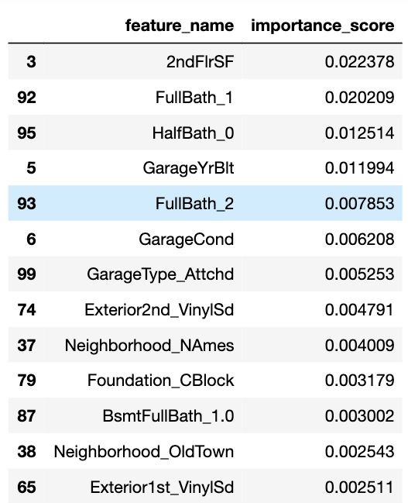
Gradient Boosting
Feature Importance via Gradient Boosting
Feature Importance Score
Feature Dropped by Lasso

Slide 24






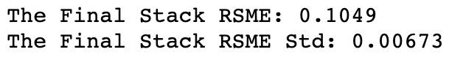
Stack Regressor
Stack All Models(ridge, lasso, elastic, xg boosting, g boosting) and Price Prediction
Lasso
RMSE = 0.1071
0.30
Prediction 1
Ridge
RMSE = 0.1091
Prediction 2
0.10
Training Data
Elastic Net
RMSE = 0.1072
Prediction 3
0.25
Meta
Gradient Boosting
RMSE = 0.1080
0.25
Prediction 4
XG Boosting
RMSE = 0.1122
Prediction 5
0.10

Slide 25
Thank you!

